Slide 1
Feeder Protection - Pilot Wire & Current Differential
Karl M.H. LAI

Slide 2
Requirement on Working on Pilot Wire
Add a new rule in CLPP E&M SR
(after Section 5.4.12.2)
PSOM2201 – Precautions for Working on Transmission and Distribution Pilot Cable or Fibre Optic Cable
5.3.12.3
The work or test on pilot cables with risks of triggering the operation of the switching devices shall be carried out by an authorised person who shall receive instructions directly from a control engineer. After the risk has been removed, the work or test on the pilot cable shall be carried out a competent person in accordance with approved procedures.
Inform all users to divert their channel (protection, intertrip, oil alarm, PSA) before work.
Inform SO before work.
Accept monitoring alarm (MA) before work.
# Require AP to identify the pilot core / cable if there is no clear identification.
TI115 – Avoidance of Danger from Induced Voltage when Working on Cable
Insulated working shall be carried out, as appropriate, with the use of effective combination of any two of the following approved items,
Insulation Mat / Insulation Boot
Insulation Gloves
Insulation Tools
# All tools / equipment must be inspected for any damage and defects before use and any tools / equipment found faulty must be withdrawn from service.
1. Risk of Triggering Switching Device by cutting a wrong pilot (Solkor)
2. Risk of Channel Defective Alarm leading to Forced Outage (GRL150)
AP shall make sure the risk of triggering switching device is removed to allow CP with adequate knowledge perform the task

Slide 3

Pilot Wire Protection in Circuit
Pilot Loop Resistance = 1000Ω
R
Rpp = 490Ω
71
R_{L}
Rpp
4V_{YE}
3V_{BE}
Y
$\sqrt{3}$V_{X}
Ra = 1.9kΩ
Ra = 1.9Ω
B
5V_{RE}
Pilot Continuity = 4.8kΩ
72
N
T B
Minimum 4 pair cores for 71-72
> 2MΩ at 500V Megger (71 – E, 72 – E, 71 – 72)
R = 8.3Ω/km, C = 60nF/km
Summation CT:
RY : YB : BN = 1: 1: 3
V_{RE} : V_{YE} : V_{BE} = 5: 4: 3
I_{RE}: I_{YE} : I_{BE} = 12: 15: 20
V_{K} > 50 + I_{F} / N (R_{CT} + 2R_{L})
Relay Side
PMB

Slide 4
Pilot Wire Relay (Solkor Vs HOR4)
PILOT WIRE PROTECTION RELAY
(SOLKOR RF – VEDETTE CASE)
PILOT WIRE PROTECTION RELAY (HOR4)
6
R_{PP}
20
10
R_{A}
R_{PP}
12
A11
T3
A11
T3
A31
7
A31
9
8
8
A51
A51
PILOT WIRE
PILOT WIRE
7
A71
9
A71
N
19
T4
5
T4
10
18
N1
17
11
1
3
K1
K1
TRIPPING
K3
TRIPPING
2
K3
4
11
15
K1
PW REPEAT
(for alarm & BFP)
K1
PW REPEAT
(for alarm & BFP)
16
K11
12
K11
1
K1
13
K1
K43
INTERTRIPPING (for HSI or Pilot Intertrip Send)
14
K43
INTERTRIPPING (for HSI or Pilot Intertrip Send)
2

Slide 5
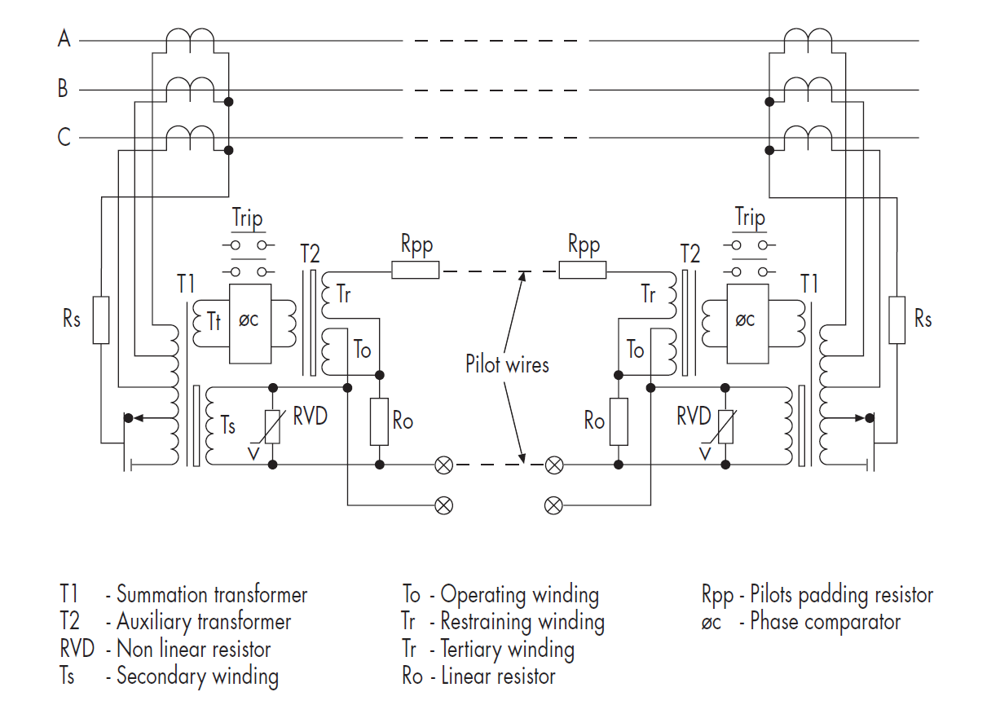
Pilot Wire Relay (Translay S)
A hybrid relay using hard wire circuit and signal processors.
Component
MBCI : Differential Relay
Phase comparison relay comparing (2I_{X} + I_{Y}) and (I_{X} + 2I_{Y})
MRTP: Supervision Relay
Detect pilot open / close condition by DC injection through the pilot loop
MCRI: Overcurrent Relay
“OC start” contact to energize BI at MBCI for differential operation to avoid unstable operation at pilot open condition
MVTW: Destabilizing Relay
Provide a short path to drain out current at To so that no current can be compared, while opening the pilot.
Inject an 80Hz 20mA to remote end for Intertripping.

Slide 6
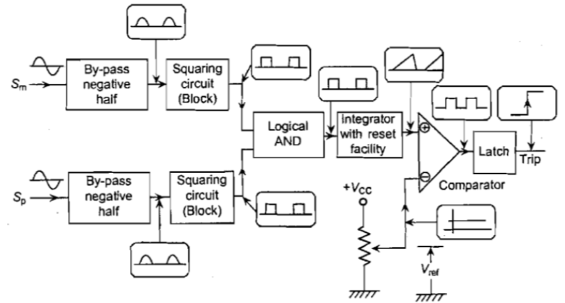
Pilot Wire Relay (Translay S)
Phase Comparator based on Coincident Principle
I₁ : restraining (stabilizing) effect to remote end
I₂ : operating component
I₃
I₁
I₂
I_{IN}
Open Pilot
Short Pilot
I₁ : I₂ = R_{O} : (2R_{PP} + R_{O})
I_{IN} : I₁ = (2R_{O} + 2R_{PP}) : R_{O}
I₃ : I_{IN} = (T_{O} I₂ – T_{r} I₁) : (2R_{O} + 2R_{PP})/R_{O} x I₁
Effect of Open Pilot
All current goes into operating winding T_{O}.
Effect of Short Pilot
Increased current at restraining winding Tr.

Slide 7
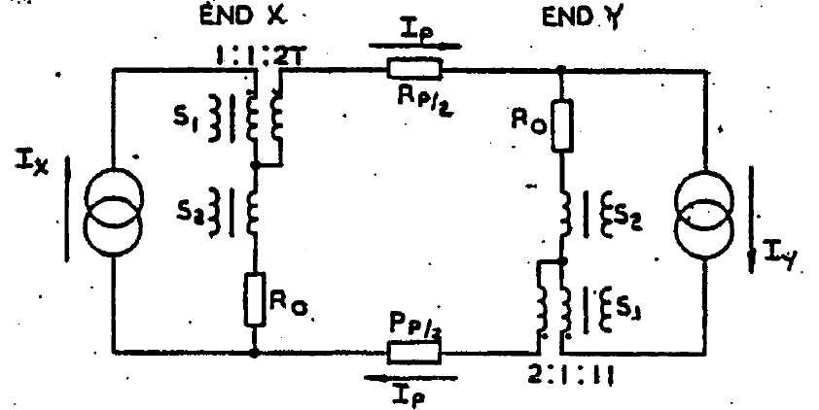



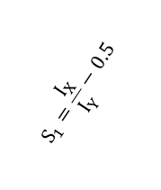

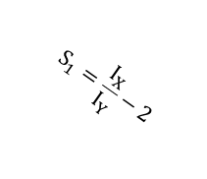





Pilot Wire Relay (Translay S)
$$+j\frac{I_{X}}{I_{Y}}$$
$$\frac{I_{X}}{I_{Y}}$$
$$S_{1}=\frac{I_{X}}{I_{Y}}−2$$
$$S_{1}=\frac{I_{X}}{I_{Y}}−0.5$$
$$0$$
$$\frac{I_{X}}{I_{Y}}$$
$$0.5$$
$$1.0$$
$$1.5$$
$$2.0$$
Equivalent Circuit of Translay S
S₁ = I_{X} – 2 I_{P}
Assume R_{O} = R_{P} , then
S₁ = I_{X} – 2 (I_{X} / 3 + I_{Y} / 3)
Neglecting the multiple factor (x3)
S₁ = I_{X} – 2 I_{Y} or S₁ / I_{Y} = I_{X} / I_{Y} – 2
S₂ = 2/3 I_{X} – 1/3 I_{Y}
Similarly, S₂ = 2 I_{X} – I_{Y} or S₂ / I_{Y} = I_{X} / I_{Y} – 0.5
Stability Zone
$$−j\frac{I_{X}}{I_{Y}}$$
Assumption: Tr = 2T_{O} and R_{O} = R_{P} (pilot loop resistance).
The phase comparator has angular limits of ±90º giving a circular characteristics.
For values of 0.5 < I_{X} / I_{Y} < 2.0 and phase differences exceeding 90º between S1 and S2, The system is stable.

Slide 8
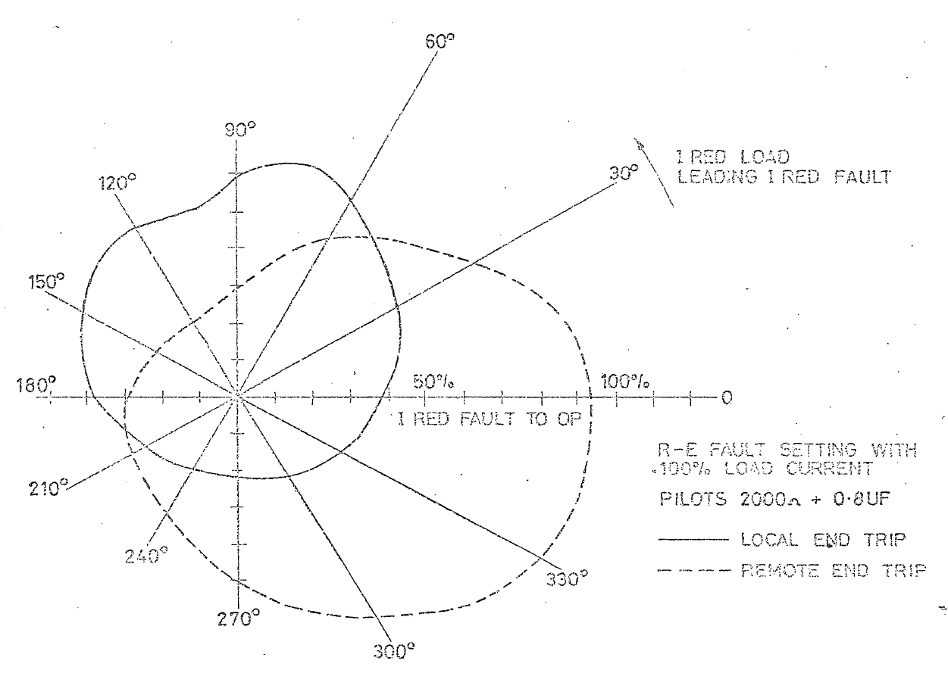
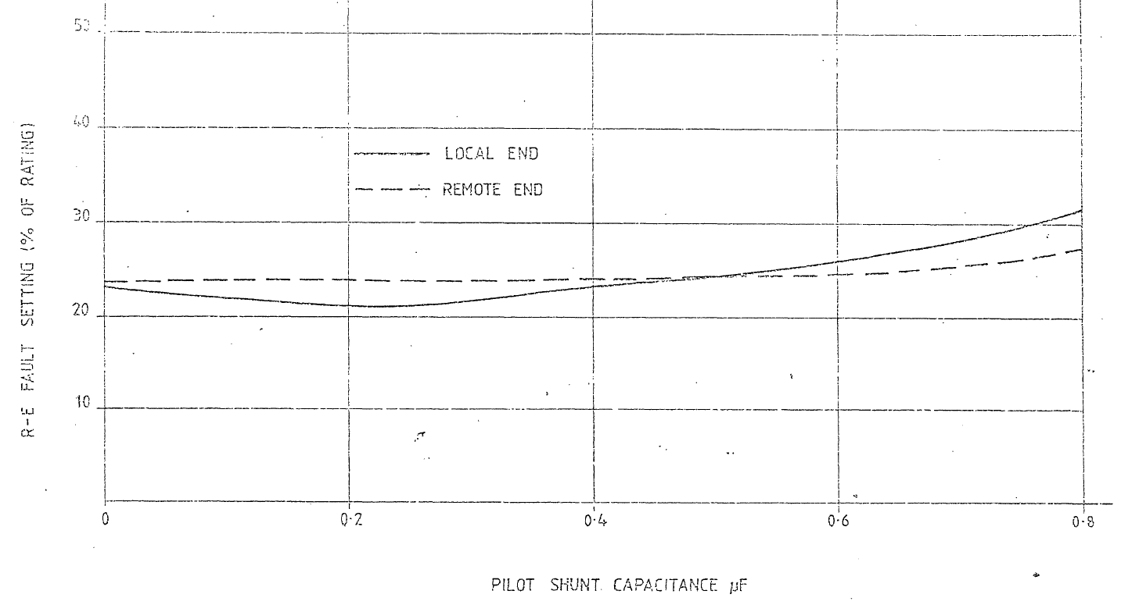
Pilot Wire Protection Setting
Type of fault | Operating Current [A] in Secondary
Type of fault | Pilot Normal | Actual Pickup | Pilot Open | Pilot Short
A-E | 0.25 | 0.235 | 0.125 | 1.375
B-E | 0.32 | 0.294 | 0.16 | 1.75
C-E | 0.42 | 0.392 | 0.21 | 2.375
A-B | 1.25 | 1.18 | 0.625 | 7.25
B-C | 1.25 | 1.18 | 0.625 | 7.25
A-C | 0.62 | 0.588 | 0.32 | 3.625
ABC | 0.72 | 0.678 | 0.36 | 4.125
Effect of Load Current
# Through Fault 50x Current Stable
Effect of Pilot Capacitance

Slide 9
Pilot Wire Protection Condition
# Relay Mal-operates when I_{R} > I_{pickup}
# Diode are forward biased at diff. half cycle.
Internal Fault:
Open Pilot:
+
Open
+
+
-
External Fault:
Pilot Low Insulation:
Shorted
+
-
+
-
# Normal Load Condition – not operate
# Faulted Condition – may mal-operate

Slide 10
Pilot Wire Stability Test
A
AC/ DC Pilot Current
A
A
DC Op Coil Current
A
Secondary Injection Test Result
+
+
Detected by Pilot Continuity Test
Pilot Normal
Condition | Op Coil DC Current | Pilot AC Current | Pilot DC Current
Before Test | 5 mA | 4.75 mA | 0.09 mA
Pilot Open | 7.45 mA | 6.81 mA | 0.01 mA
Pilot Crossed | 6.45 mA | 5.29 mA | 2.56 mA
Pilot Normal | 4.85 mA | 4.75 mA | 0.12 mA
+
+
Pilot Open
+
+
Pilot Crossed

Slide 11
Pilot Wire Protection – Setting Requirement
The following data is required –
Power System Voltage and Frequency
Method of system earthing to determine effective zero sequence charging current during earth faults.
Effective source impedance to calculate maximum internal fault levels and relate these to CT and relay short time rating
Feeder length and impedance to calculate maximum through-fault levels for CT requirement.
In-zone capacitance current to determine minimum allowable fault setting
Load current of feeder to check continuous rating and assess against minimum fault setting for load bias effect.
Minimum fault current for phase and earth-faults to check that they are at least twice the obtained settings.
CT ratio, excitation curve, winding resistance and loop lead burden resistance for CT’s at each end to check CT requirement.
Pilot resistance, pilot capacitance and route length to check against limits and effect upon settings.
Pilot insulation level between cores to check against required value of 500 volts.
Pilot insulation level between cores and earth to check with estimated induced voltage and earth-shift voltage levels.
12. Details of any tapped transformers to check against 20% limit.

Slide 12
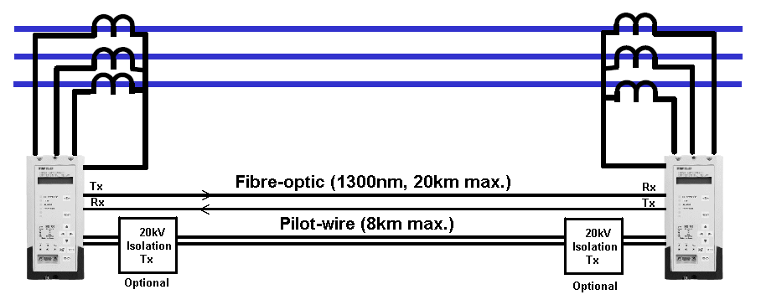
Current Differential Relay
I_{L}
I_{R} = 0
Phase-segregated differential protection
Current setting = DIFI1 = 30% (120A)
Blocked by Channel Failure & Inrush Current (2nd harmonic)
Different CT ratios and relay rated currents at 2 ends
Differential inter-tripping (Transfer trip 1)
Operating time = 30ms (FO channel)
Operating time = 40ms (PW channel)
OC Check for Diff.: OC5 = 100%
No mal-tripping when CT polarity reversed, CT wiring loosen, or differential protection mal-operates
CB at weak-infeed end will not trip → Need differential Inter-tripping
Optical Interface MUX-64
Telecom MUX
Optical Interface MUX-64
Telecom MUX
FOC
G.703
G.703
FOC
Trip Logic
Stay Close if no TR1
Strong Source
Trip
Weak Source
I_{L} > 400A
I_{R} < 400A
Any Trip
Any Trip
OR
OR
DIFF PROT. (0.3A)
Feeder Fault, Diff Trip
DIFF PROT. (0.3A)
&
&
OC CHECK (1.0A) / EF CHECK (0.3A)
DIFF TRIP
OC CHECK (1.0A) / EF CHECK (0.3A)
BBZ / RMU CC Trip
&
&
BBZ / RMU CC Trip
OC CHECK (0.3A)
PIT TRIP
OC CHECK (0.3A)
Busbar Fault
CC Fault, PIT Trip

Slide 13
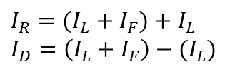



Concepts in Current Differential Relay
Define restraint current and differential current as: $I_{R}=\left|I_{IN}\right|+\left|I_{O}\right| I_{D}=\left|I_{IN}+I_{O}\right|≈\left|I_{IN}\right|−|I_{O}|$
Case 1: Internal Fault
Case 3: External Fault with 1 CT saturated
I_{L}
I_{L}
I_{O}
I_{L}
I_{L}
I_{IN}
I_{IN}
I_{O}
$I_{R}=(I_{L}+I_{F})+I_{L}$
$I_{D}=\left(I_{L}+I_{F}\right)−(I_{L})$
$I_{R}=(I_{L}+I_{F})+∆I_{CT}$
$I_{D}=\left(I_{L}+I_{F}\right)−∆I_{CT}$
I_{F}
I_{F}
Case 2: External Fault
Case 4: Normal Load
I_{L}
I_{L}
I_{L}
I_{L}
I_{L}
I_{L}
I_{O}
I_{O}
I_{IN}
I_{O}
I_{IN}
I_{IN}
$I_{R}=2(I_{L}+I_{F})$
$I_{D}=0$
$I_{R}=2I_{L}$
$I_{D}=0$
I_{F}
I_{F}

Slide 14



Concepts in Current Differential Relay
From last page,
Case 1: Increasing Load Current I_{L}
Case 2: Increasing Fault Current I_{F}
I_{D}
I_{D}
I_{D}
I_{O} < 0
I_{O} < 0
I_{O} < 0
$↑$I_{F}
$↑$ CT saturation through fault Locus
$↑$ CT saturation through fault Locus
$↑$ CT saturation through fault Locus
Internal Fault
Internal Fault
Internal Fault
No load (I_{L} = 0)
No load (I_{L} = 0)
$↑$I_{L}
External Fault (CT saturate)
External Fault (CT saturate)
External Fault (CT saturate)
External Fault
External Fault
External Fault
I_{R}
Normal Load
I_{F}
Normal Load
I_{F}
I_{R}
Normal Load
I_{F}
I_{R}

Slide 15

Concepts in Current Differential Relay
Case 3: Degree of CT Saturation
Setting 1: DIFI1
Setting 2: Slope 1
I_{D}
I_{D}
I_{D}
I_{O} < 0
$↑$I_{F}
I_{O} < 0, Reverse Current
I_{O} < 0, Reverse Current
$↑$ CT saturation through fault Locus
Internal Fault
Internal Fault
Internal Fault
No load (I_{L} = 0)
$↑$I_{L}
Operate
Operate
External Fault (CT saturate)
External Fault (CT saturate)
Slope 1
External Fault (CT saturate)
External Fault
DIFI1
DIFI1
Restraint
External Fault
Restraint
External Fault
I_{F}
I_{R}
$↑$I_{L} , I_{F}
I_{F}
I_{F}
Normal Load
Normal Load
I_{R}
Normal Load
I_{R}
Note: 3*Charging + Tee-off < DIFI1 < 1/3 Min Fault - cater for CT errors, Tee off and Charging
Note: CT error increases with input current Hence, 1/6 slope 1 setting is provided. → Why 1/6 ?

Slide 16


Concepts in Current Differential Relay
$I_{R}=I_{F}+2I_{L}$
$I_{D}=I_{F}$
Recall internal fault:
Observation
Some points are not differentiable. CT saturation in through fault OR Internal fault with increasing load?
Let’s have a setting 2 DIFI2, not trip until overload, and trip at high CT saturation (i.e. nearly no output/ 50% output of ideal). $I_{D}=I_{R}−2 DIFI2$
I_{D}
DIFI2 > I_{FL} (No overload)
2DIFI2 < I_{F} / 2 (CT saturate) (CT output only left 50%)
Hence,
$I_{FL}<DIFI2<\frac{I_{F}}{4}$ .
Q1: Slope 2 = 1 is a must?
Q2: What is the best separation line for the two sets of dots?
I_{D}
I_{O} < 0, Reverse Current
Increasing Load current
I_{O} < 0, Reverse Current
Operate
Internal Fault
Internal Fault
Through Fault CT saturation
Slope 2
Operate
External Fault (CT saturate)
Slope 1
External Fault (CT saturate)
DIFI1
DIFI1
Restraint
External Fault
Restraint
External Fault
Normal Load
Normal Load
I_{F}
I_{R}
I_{F}
I_{R}
I_{D} = I_{R} – 2 DIFI2
– 2 DIFI2

Slide 17
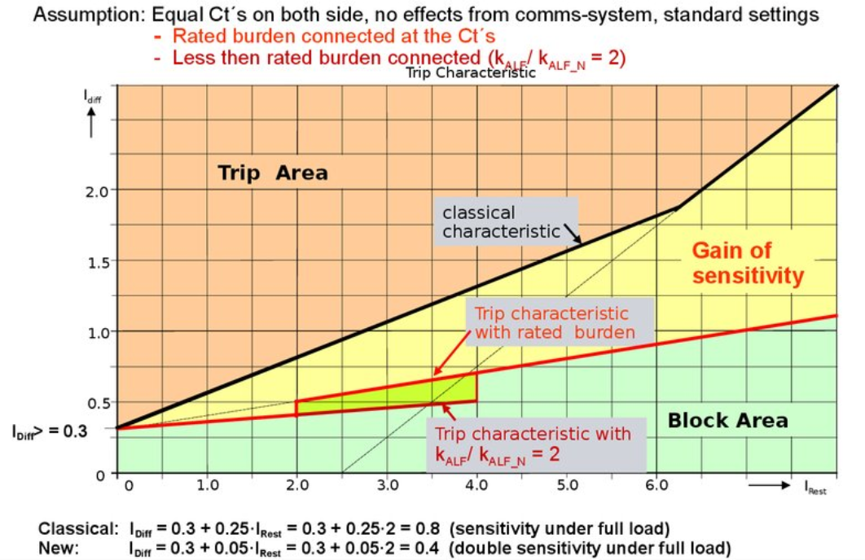
Concepts in Current Differential Relay
Setting Consideration –
Minimum Fault Level
Circuit Charging Current
Circuit Length
System Voltage
CT Ratio
Summary:
Siemen 7SD610 Line Differential Relay:
Tuning DIFI2
I_{D}
I_{O} < 0, Reverse Current
2DIFI2
Internal Fault
Old
Operate
Tuning
External Fault (CT saturate)
DIFI1
Restraint
External Fault
New
I_{F}
I_{R}
Problem: Is I_{D} – I_{R} characteristics unique? What is the benefits with this setting?
https://en.ppt-online.org/55658

Slide 18
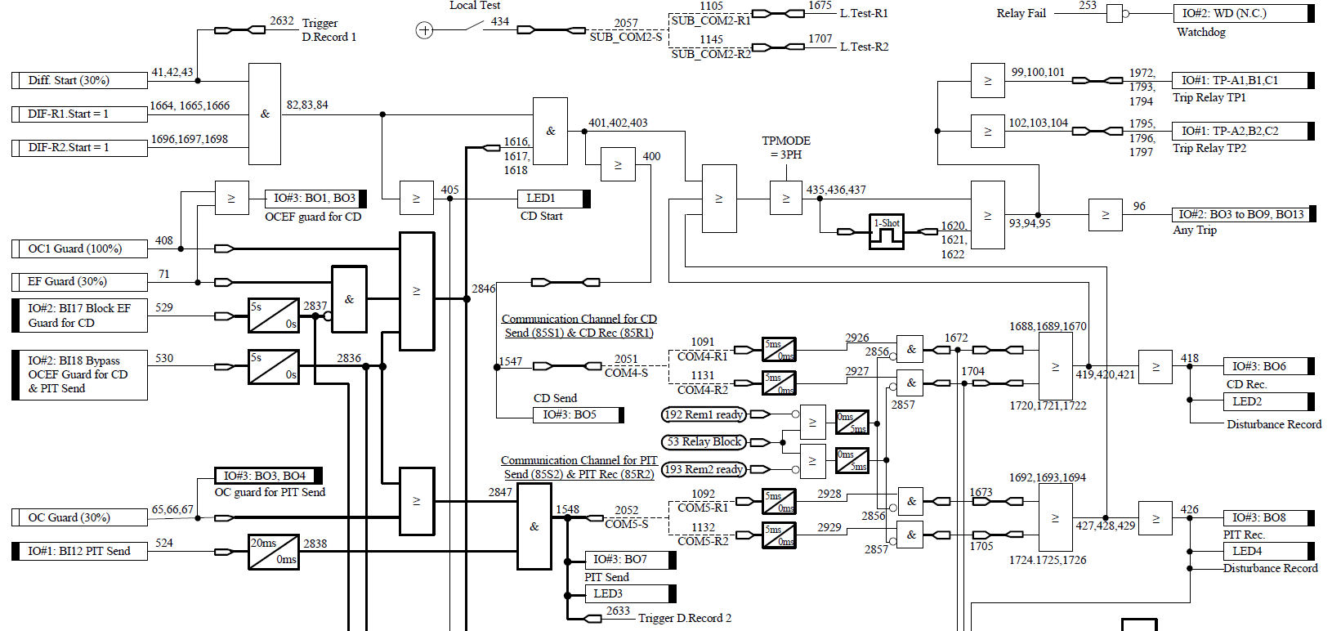
Current Differential - GRL100 Logic
Diff Element + OC Guard
Trip upon 1) Diff. + OC Guard 2) PIT Rec. (from remote PIT Send by HZBBZ/CC) 3) CD Rec. (from remote Diff + OC Guard)
OC Local Guard before sending PIT

Slide 19
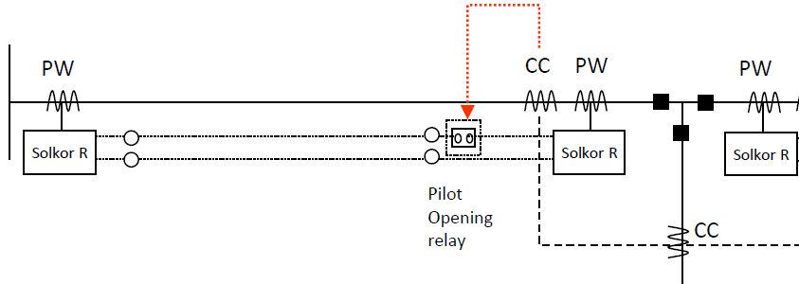
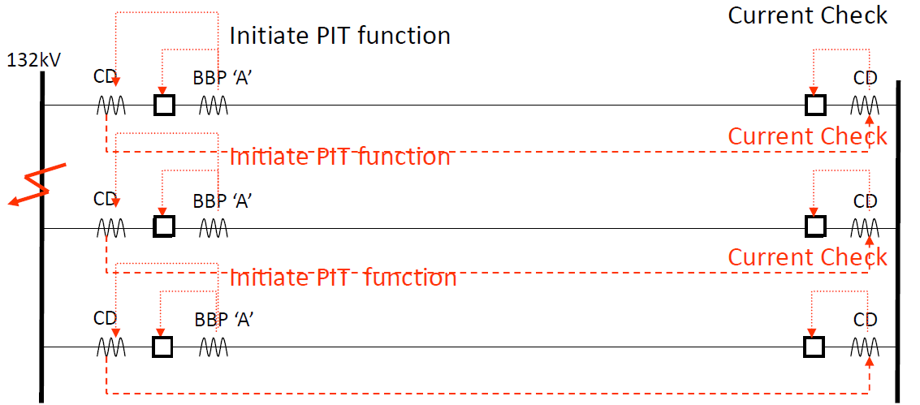
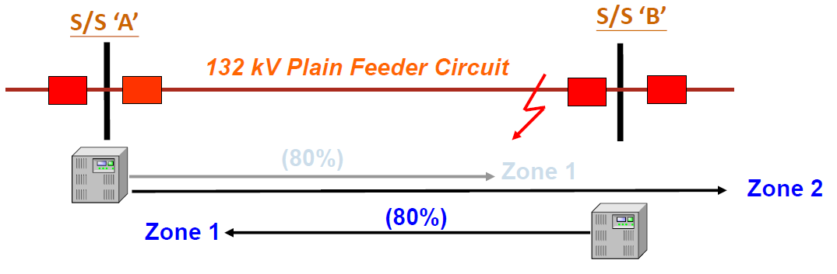
Intertrip in History - Unstabilizing
Pilot Opening / Unstabilizing Pilot
Trip instantaneously with open pilot current
RMU CC Operates
Pilot Opening Relay N.C. contact opens
Solkor Open Pilot
Remote S/S trips with open pilot current
CD – Permissive Intertrip
Trip instantaneously with “local” current check
Distance Protection Acceleration (DPA)
Trip instantaneously with Zone 2 fault

Slide 20
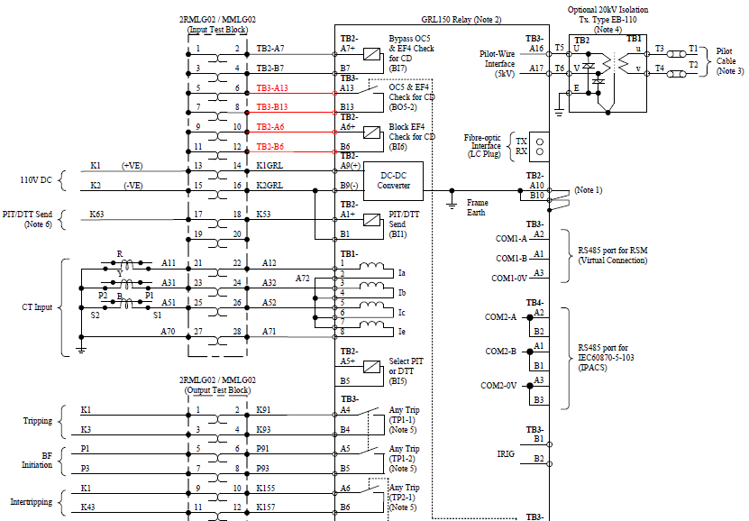
Direct Transfer Trip (DTT) Vs Permissive Intertrip (PIT)
SHE132
MOB132
To avoid the line left energized after HZBBZ, inter-tripping facilities is provided
Tripped by HZBBZ
Provide a +ve by
BBZ Repeat relay
Do we need to have current check before tripping?
No → Direct Transfer Trip (DTT)
Yes → Permissive Intertrip (PIT)
Any Trip Contact operates with PIT receive as well.

